Slide 2
The Health Consumers’ Council acknowledges the people who are the Traditional Owners of this Land and pay respect to all Elders past, and present. We extend our respect to all other Aboriginal and Torres Strait Islander Cultures.

Slide 3
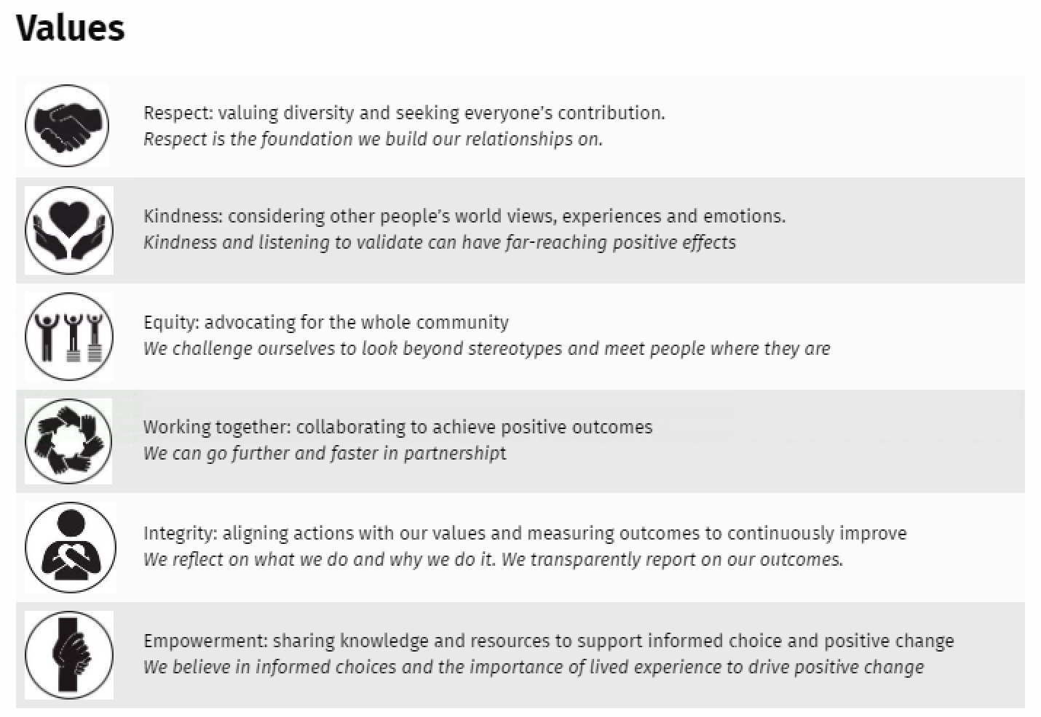
Purpose
To increase the capacity of all people to influence the future direction of health care and to make informed choices.
Notes:
Once upon a time (story of HCC in 2015 – staff and Board not working together effectively, developed these definitions at our Strategic Planning Day). Demonstrate the values reflection

Slide 4
Agenda…
Introductions
Background to today
Q1 How do we reach people who aren’t here?
Q2 What would an ideal SHABBV service look like?
Close, Next steps

Slide 5
Sexual Health and Blood Borne Virus Advisory Committee and Consumer Engagement – The Story so far…
SHABBVAC
July 2018
X3 meetings per year –
Mar Jul Oct
3 Consumer Members to SHABBVAC
Oct 2019
Bringing in a wider voice –
Dec 2019/ Feb 2020 Sessions
Alliance Meeting 01, March 2020

Slide 6
Key focus: ensure that outcomes for consumers are captured as part of the process of reporting on the Department of Health’s suite of Strategies

Slide 7
Q1. How do we reach people who aren’t here?

Slide 8
Q2. What would your ideal sexual health and blood borne virus service look like?

Slide 9
How to stay in touch
Health Consumers Council webpage:
https://www.hconc.org.au/issues/sexual-health-and-blood-borne-viruses-2/
WA Department of Health webpage on SHABBVAC:
https://healthywa.wa.gov.au/Articles/U_Z/WA-Sexual-Health-and-Blood-borne-Viruses-Advisory-Committee
Consumer Portal – Primary Health Exchange – WA Primary Health Alliance
https://phexchange.wapha.org.au/SHaBBVAC

